Slide 1


Key Policy Improvements
Special Education Bulletin Updates

Slide 2
We are Louisiana’s oldest and largest grassroots organization with over 9,000 members affiliated through 22 local chapters across the state. A board of directors and a delegate body of representatives from each local chapter guides the work of The Arc.

Slide 3
Celebrating our Students with Disabilities
● Students with disabilities outperformed and outgrew students with disabilities across the nation on NAEP 2024.
● Students with disabilities have shown increased mastery on LEAP for the past three years in a row.
● In 2024, students with disabilities’ growth surpassed their nondisabled peers by 1%.
● Louisiana’s most recent cohort graduation rate increased for students with disabilities.

Slide 4

The Key Policy Improvements

Slide 5
2022-2023
Bulletin 1508 - This approved policy update brought Louisiana into alignment with national standards and eligibility requirements for students with visual impairments:
• Adds the loss of “functional vision” to eligibility criteria and adds specifics to what may be considered for blindness resulting from a medical condition.
• Adds clarity that a braille skills inventory should be based on “grade level literacy and math standards”
• Emphasizes that functional vision assessments should include the “educational environment” where the student spends their time learning and that a “certified teacher of the blind or visually impaired or an orientation and mobility specialist” should conduct the assessment

Slide 6

22-23 Continued
• Adds “if necessary, a low vision assessment” to determine daily vision supports such as optical devices, such as monocular telescopes or magnifiers
Bulletin 741 - Special Education Cameras in Certain Special Education Classrooms
• Added language to Bulletin 741 to align with Act 588 by Senator Foil

Slide 7
2023-2024
December 2023, Bulletin 1573 - approved bulletin revisions improve the state’s dispute resolution processes by:
● Requiring LDOE to contact complainants when their complaint is lacking required information and offering assistance with correct completion.
● If the complaint does not meet the criteria for investigation, offering other resources to pursue a resolution.
● LDOE will internally share certain complaint information to improve program quality, monitoring, and school improvement efforts.
● Beginning in fall 2024, redacted complaint information will be posted to the LDOE website.

Slide 8
23-24 continued
January 2024, Bulletin 1922 - approved bulletin revision allows LDOE to appoint special consultants to LEAs without local board approval
March 2024, Bulletin 1706 - approved bulletin revisions improved consistency and clarity in several special education process:
● Expands the types of IDEA complaints that can be filed and extends allowable complaints to be filed on allegations up to two years prior.
● Quantifies response period regarding parent request for evaluation, parent request for independent evaluation, or changes/decisions regarding identification, evaluation, placement, or FAPE provision.

Slide 9

23-24 continued
● Requires provision of a draft IEP at least three days prior to an IEP meeting, upon parent request.
● Adds student’s disciplinary and behavioral history and records and available medical information related to behavior to information considered before changing a child’s placement due to behavior

Slide 10
Other Improvements
● Personnel:
  ○ Special education attorney and ombudsman
    ○ Additional complaint investigation and monitoring staff
  ● Special Education Playbook focusing on inclusive instructional practices
  ● Sped Fellows expansion
  ● Updated assistive technology framework
  ● SEAP just endorsed significant changes to Bulletin 1508, that will go to BESE in April for approval

Slide 11

What’s Next

Slide 12
Looking Ahead
● Navigating the new special education family webpage.
● The LDOE will release a new Educational Rights handbook for parents of students with disabilities.
● If you haven’t done so already, please complete our IDEA grant application stakeholder input survey.
● SEAP applications will open later this spring.

Slide 13


Slide 14
Family Resources
● Family Special Education Resources – New Website: Family Special Education Resources
● Louisiana’s Educational Rights of Children with Disabilities coming soon!
● Special Education Ombudsman, Chastity Hatsfelt
  disputeresolution.doe@la.gov ○ 1-877-453-2721, Option 2

Slide 15

How to get Involved

Slide 16
How to get involved and stay informed
Subscribe to State Register
Follow the Louisiana Legislature
Follow in the Louisiana Board of Elementary & Secondary Education
Follow and participate in their different advisory committees
Participate in SEAP Meetings
Attend local SEAC Meetings
Attend local school board meetings
Join advocacy groups/organizations
Notes:
These are all the ways that you can get involved from the federal level down to the local level. Not sure you can make all these meetings, that is ok. You can always sign up to receive noticed from the different registers that will allow you to comment on proposed rules and rule changes. You can submit comments to different policymakers, but it is crucial that you stay informed and get involved in some way.

Slide 17
Louisiana Register
State statutes direct agencies to engage in the rulemaking process to implement new state and federal laws.
This procedure allows for public input as well as legislative involvement.
To subscribe to the Louisiana Register publication notification email list, send an email to osr-reg-subscribe-request@listserv.doa.la.gov with "Subscribe" in the Subject Line.
Notes:
The Louisiana Register is a monthly publication which provides access to the certified regulations and legal notices issued by the executive branch of the state government. State statutes direct agencies to engage in the rulemaking process in order to implement new state and federal laws. Such rulemaking actions are published in the Louisiana Register in accordance with the Administrative Procedure Act. This procedure allows for public input as well as legislative involvement.

Slide 18
Louisiana Legislature
Find My Legislators - Louisiana State Legislature
Education Committee (louisiana.gov)
Senate Education Committee (la.gov)
The 2024 Regular Legislative Session just ended on April 14th.
Notes:
The primary function of any legislature is to create laws. State legislatures also approve budget for state government. They may establish government agencies, set their policies, and approve their budgets. In even-numbered years, a general session convenes at noon on the second Monday in March to extend for no longer than 60 legislative days during a period of 85 days. In odd-numbered years, a limited jurisdiction session (fiscal session) convenes at noon on the second Monday in April for no longer than 45 legislative days during a period of 60 days. Legislators are only allowed to file 5 non-fiscal bills. The legislature also may convene for extraordinary sessions and for veto sessions.
Most of the issues related to Education will start in either House Ed or Senate Ed. Sometimes these bills might have fiscal notes attached and if they clear the education committee, they will be referred to either House Appropriations or Senate Finance for discussion and a vote.
The funding mechanism for all K-12 education is the MFP: BESE develops the formula and submits it to the legislature for either a yes or no vote. The Legislature has no power to amend the formula, and if they vote no it will go back to BESE to allow them to make changes based on recommendations. If no changes are made, and the legislature doesn’t vote for the formula then the previous years MFP will stay in place.

Slide 19
BESE Board
The Louisiana State Board of Elementary and Secondary Education (BESE) is the administrative body for all Louisiana public elementary and secondary schools
Louisiana State Board of Elementary and Secondary Education (BESE)
BESE adopts regulations and enacts policies governing the operations of the schools under its jurisdiction and exercises budgetary oversight of their educational programs and services.
Meet every month: Microsoft Word - 2024 Board Meeting Calendar (louisiana.gov)
Notes:
BESE is the administrative policymaking body for elementary and secondary schools in Louisiana¹²³. It was established by the Louisiana Constitution and is responsible for governing all Louisiana public schools, including secondary schools (middle and high schools) and special schools for the deaf, blind. BESE adopts regulations and enacts policies governing the operations of the schools under its jurisdiction, and exercises budgetary oversight of their educational programs and services. They meet every month this year except, May, July, September and November
The powers and duties of the State Board can be broadly grouped into six main categories, which include:
Enacting policies and adopting regulations governing the statewide operations of public and nonpublic elementary and secondary schools, including special schools and entities in Special School District # l;
Exercising administrative oversight over functions of the state's three special schools (blind, deaf, physically handicapped), and Special School Districts #1 and #2, including personnel, budget, and program operations;
Administering and serving as the fiscal agent and as program control agent for the Education Quality Trust Fund (8(g) programs;
Conducting administrative hearings and serving as the "court of last resort" prior to judicial proceedings in cases/controversies deriving from Board actions;
Exercising budgetary and fiscal control over the educational programs and services at the elementary and secondary (state and federal funds);
Preparing the MFP and presenting it to the Legislature for approval and distributing funds to local school systems.^{[5]}

Slide 20

Special Education Advisory Panel (SEAP)
SEAP is established in accordance with the requirements of IDEA 2004 SEC. 612 State Eligibility (21) and provides policy guidance regarding special education and related services for children with disabilities in Louisiana.
The majority of the panel members must be individuals with disabilities or parents of children with disabilities (ages birth through 26).
2024 Meetings: January 24th, March 20th, June 19th September 25, and November 12th.
Notes:
The IDEA requires that each state establish and maintain an advisory panel for the purpose of advising the state special education staff regarding the education of eligible children with disabilities. This includes advising the state on the education of students with disabilities who have been convicted as adults and are incarcerated in adult prisons.
Panel membership must be composed of individuals who are representative of the state’s population and involved in, or concerned with, the education of children with disabilities. A majority of the members of the panel must be individuals with disabilities or parents of children with disabilities. Panel membership should include individuals who represent the following areas:
• Parents of children (aged birth through 26)
• Individuals with disabilities
• Teachers
• Representatives of institutions of higher education that prepared special education and related services personnel
• State education officials
• Local education staff
• Administrators of programs for children with disabilities
• Representatives of other state agencies involved in the financing or delivery of related services to children with disabilities
• Representatives of private schools
• Representatives of public charter schools
• At least one representative of a vocational, community, or business organization concerned with the provision of transition service to children with disabilities
• Representatives from the state juvenile agency
• A member who represents homeless children
• Representatives from adult corrections agencies
• A member from state child welfare responsible for child care
• Others as appropriate

Slide 21
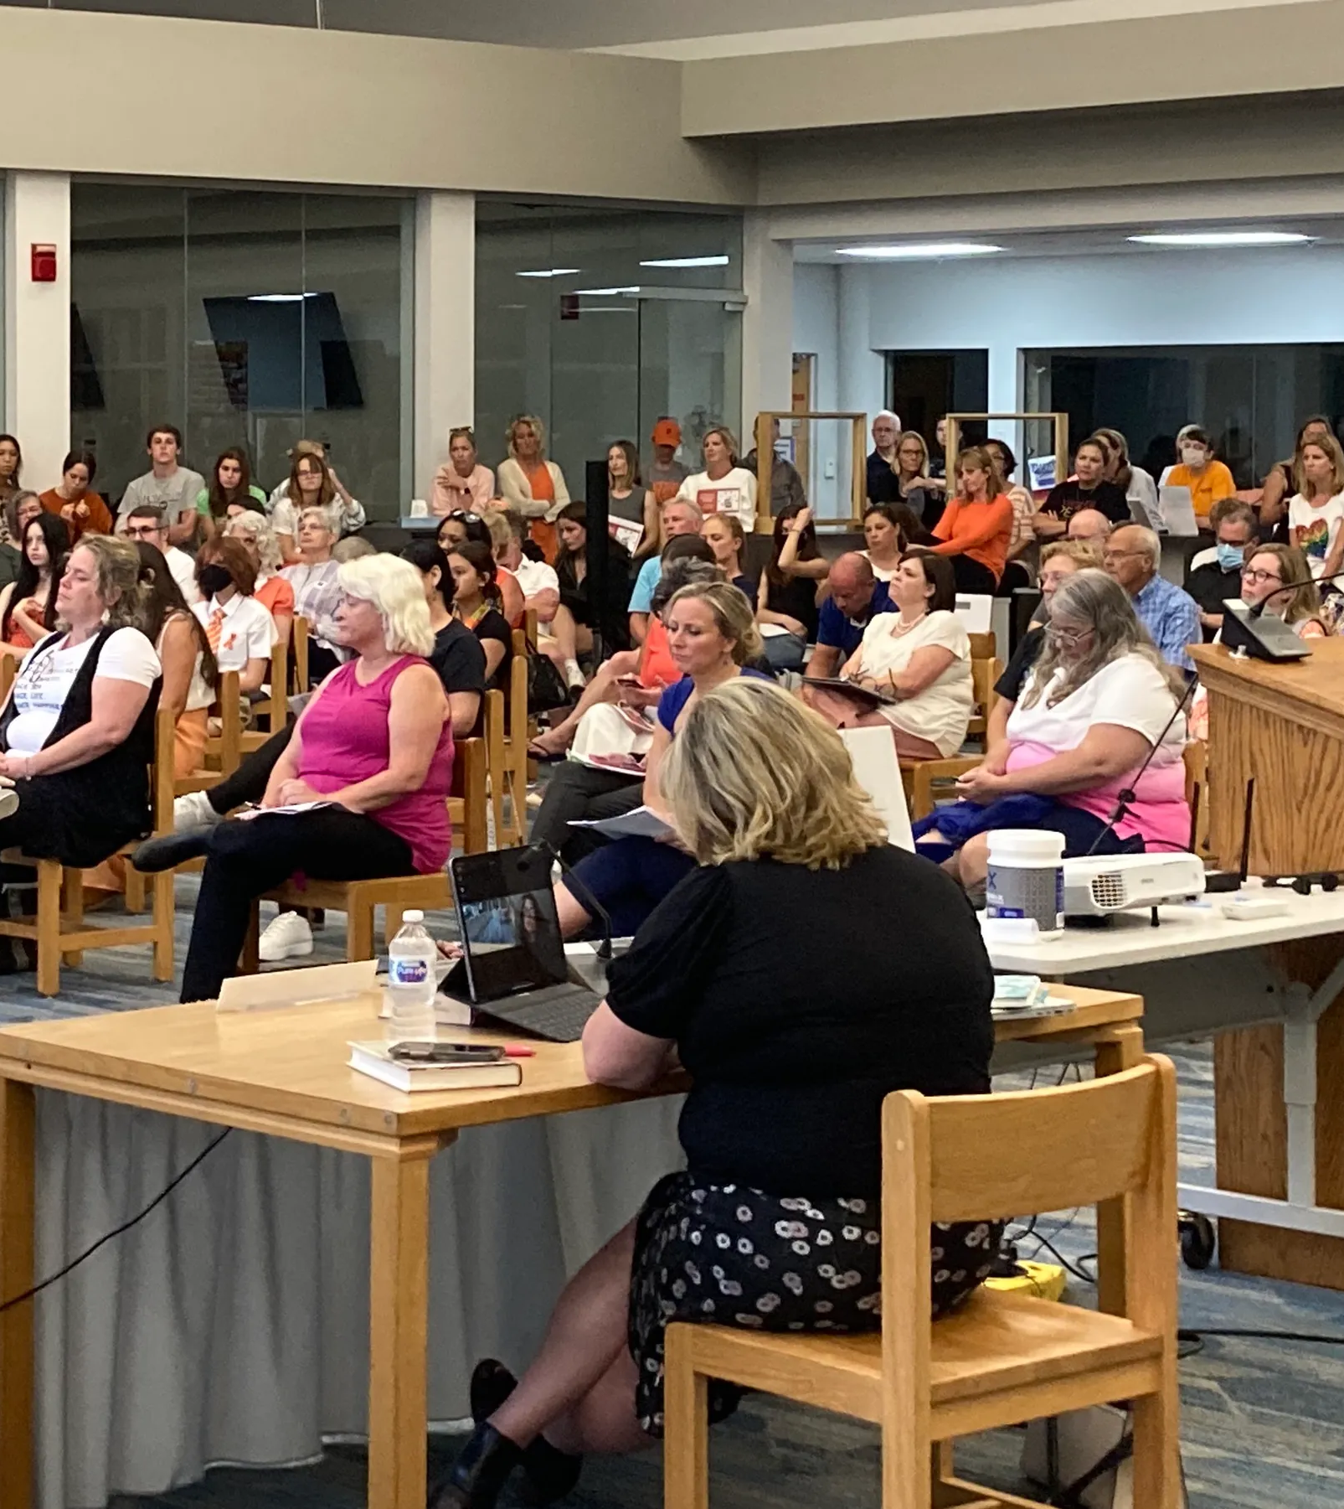
Local Special Education Advisory Committees (SEACs)
Louisiana’s Act 274—During the 2019 Regular Session of the Louisiana legislature, each local public-school superintendent and the administrative head of each charter school or other public school was required to create local Special Education Advisory Councils by January 1, 2020.
At least fifty percent of the membership shall be parents or legal guardians of students with an exceptionality other than gifted and talented
Notes:
The SEAC is an advisory group made up of a variety of stakeholders but at least 50% of the members must be parents who have children that receive special education services. Each local education agency (including charters) are required to have a Special Education Advisory Committee, or SEAC). These committees advise the local school divisions of unmet needs and assist the school divisions in formulating plans for improving the performance of children with disabilities. Members are appointed by their local school board, or designee and serve on SEACs according to locally developed SEAC bylaws

Slide 22
Local School Boards
Most school board members are elected by people in their community to represent their values, views, and desires for the public schools in their district.
As elected leaders in their community, they consistently communicate with the public to keep community members abreast of challenges, ideas, and progress.
It's important to know what school boards do and how to get involved.
Notes:
Local school boards are a unit of local government that determines the policy, budget, leadership, and administration within a certain district's public schools. They were created for the purpose of implementing state legislative policy concerning public schools and locally administering the state's system of public education. Making sure schools are following the law is a big responsibility. Some of that responsibility lies with federal and state agencies. But most of it rests with local school districts. Some of their duties:
Policymaking
Hiring the Superintendent
Approving budget and curriculum
Assessing compliance with policies
Setting the school calendar
And Community Advocacy

Slide 23

Questions

